Slide 1
Course : COMP8043 – Machine Learning
Period : September 2020
Association Analysis
Session 05
KDS – Amalia Zahra, S.Kom., Ph.D.

Slide 2
Learning Outcomes
After the completion of this session, students are expected to achieve the following learning outcomes:
LO2: Describe the characteristics of various Machine Learning algorithms and understand how each of them works, including the mathematical principles underlying the algorithms.
LO3: Apply relevant Machine Learning algorithms according to individual cases/problems and perform evaluation.
LO4: Analyze the results obtained from Machine Learning experiments from several perspectives.

Slide 3
Session Outcomes
By completing this session, you will be able to:
Describe the concept of association analysis
Describe the meaning of itemsets, support and confidence
Summarize steps in Apriori algorithm
Summarize steps in FP-Growth method
Perform evaluation of association rules

Slide 4
Topics
Association Analysis
Association Rules
Itemsets, Support, and Confidence
Apriori Algorithm
Frequent Pattern Growth Methods
Evaluation of Association Rules

Slide 5
What is Association Analysis?
Given a set of transactions, find association rules that will predict the occurrence of an item based on the occurrences of other items in the transaction.
Applications:
  basket data analysis
  cross-marketing
  catalog design
  sale campaign analysis
  Web log (click stream) analysis
  DNA sequence analysis.

Slide 6
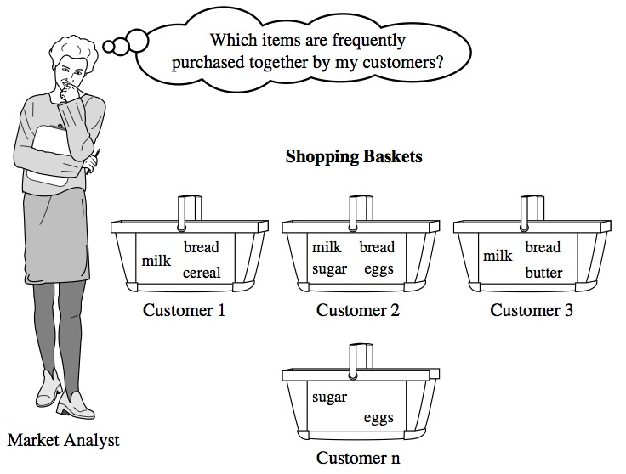
Illustration of Market Basket Analysis

Slide 7
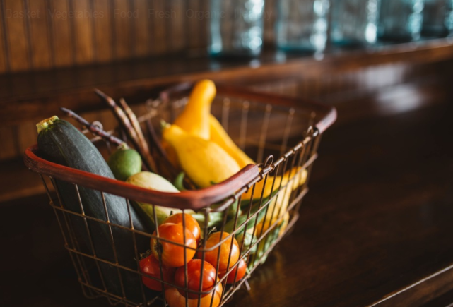
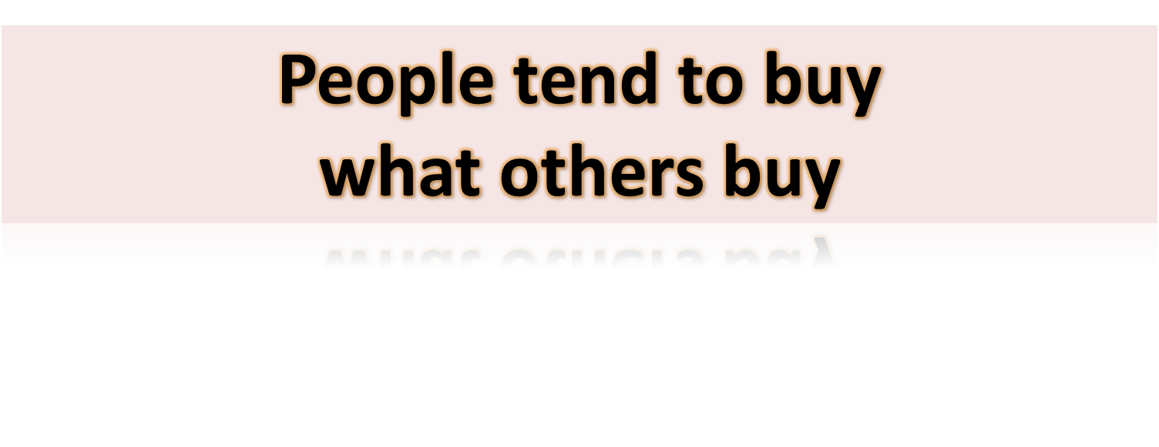

Slide 8
Business Use Case:
Sales Transactions Analysis
Huge amounts of purchase data are collected daily at the checkout counters of grocery stores.
Finding sets of frequent items bought by customer can be used to support business-related decision making:
  marketing promotions (cross-selling their products),
  inventory management,
  and customer relationship management.

Slide 9

Association Rules
Given a set of transactions, find rules that will predict the occurrence of an item based on the occurrences of other items in the transaction.
Market-Basket transactions
Example of Association Rules
{Diaper} → {Beer},
{Milk, Bread} → {Eggs,Coke},
{Beer, Bread} → {Milk},
Implication means co-occurrence, not causality!

Slide 10
Frequent Itemset
Itemset
  A collection of one or more items
    Example: {Milk, Bread, Diaper}
  k-itemset
    An itemset that contains k items
Support count (σ)
  Frequency of occurrence of an itemset
  E.g. σ({Milk, Bread,Diaper}) = 2
Support
  Fraction of transactions that contain an itemset
  E.g. s({Milk, Bread, Diaper}) = 2/5
Frequent Itemset
  An itemset whose support is greater than or equal to a minsup threshold. Minsup: minimum support.

Slide 11




Association Rule
Association Rule
  An implication expression of the form X → Y, where X and Y are itemsets
  Example: {Milk, Diaper} → {Beer}
Rule Evaluation Metrics
  Support (s)
    Fraction of transactions that contain both X and Y
  Confidence (c)
    Measures how often items in Y
    appear in transactions that
    contain X
Example:

Slide 12
Association Rule Mining Task
Given a set of transactions T, the goal of association rule mining is to find all rules having:
  support ≥ minsup threshold
  confidence ≥ minconf threshold
Brute-force approach:
  List all possible association rules
  Compute the support and confidence for each rule
  Prune rules that fail the minsup and minconf thresholds
  ⇒ Computationally prohibitive!
Notes:
Minsup: minimum support
Minconf: minimum confidence

Slide 13
Mining Association Rules
Example of Rules:
{Milk,Diaper} → {Beer} (s=0.4, c=0.67)
{Milk,Beer} → {Diaper} (s=0.4, c=1.0)
{Diaper,Beer} → {Milk} (s=0.4, c=0.67)
{Beer} → {Milk,Diaper} (s=0.4, c=0.67)
{Diaper} → {Milk,Beer} (s=0.4, c=0.5)
{Milk} → {Diaper,Beer} (s=0.4, c=0.5)
Observations:
All the above rules are binary partitions of the same itemset:
{Milk, Diaper, Beer}
Rules originating from the same itemset have identical support but
can have different confidence.
Thus, we may decouple the support and confidence requirements.

Slide 14
Mining Association Rules
Two-step approach:
  Frequent Itemset Generation
    Generate all itemsets whose support ≥ minsup.
  Rule Generation
    Generate high confidence rules from each frequent itemset, where each rule is a binary partitioning of a frequent itemset.
Frequent itemset generation is still computationally expensive.

Slide 15

Frequent Itemset Generation
Brute-force approach:
  Each itemset in the lattice is a candidate frequent itemset.
  Count the support of each candidate by scanning the database.
  Match each transaction against every candidate
  Complexity ~ O(NMw) => Expensive since M = 2^{d} !!!

Slide 16
Apriori Algorithm
Method:
  Let k=1
  Generate frequent itemsets of length 1.
  Repeat until no new frequent itemsets are identified:
    Generate length (k+1) candidate itemsets from length k frequent itemsets.
    Prune candidate itemsets containing subsets of length k that are infrequent.
    Count the support of each candidate by scanning the DB.
    Eliminate candidates that are infrequent, leaving only those that are frequent.

Slide 17

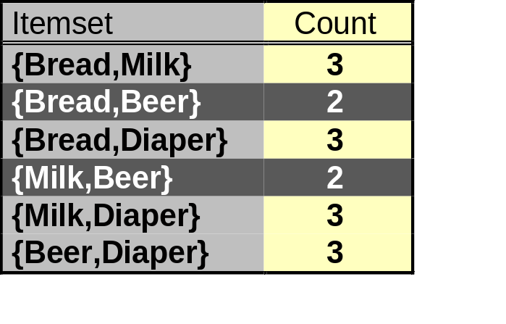
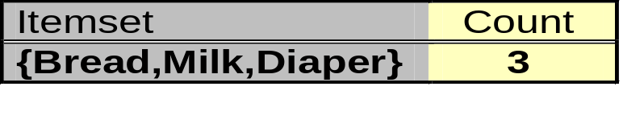
Illustrating Apriori Principle
Items (1-itemsets)
Pairs (2-itemsets)
(No need to generate candidates involving Coke or Eggs)
Minimum Support = 3
Triplets (3-itemsets)
If every subset is considered,
⁶C₁ + ⁶C₂ + ⁶C₃ = 41
With support-based pruning,
6 + 6 + 1 = 13

Slide 18
Factors Affecting Complexity
Choice of minimum support threshold
  Lowering support threshold results in more frequent itemsets.
  This may increase number of candidates and max length of frequent itemsets.
Dimensionality (number of items) of the data set
  More space is needed to store support count of each item.
  If number of frequent items also increases, both computation and I/O costs may also increase.
Size of database
  Since Apriori makes multiple passes, runtime of algorithm may increase with number of transactions.
Average transaction width
  Transaction width increases with denser datasets.
  This may increase max length of frequent itemsets and traversals of hash tree (number of subsets in a transaction increases with its width).

Slide 19
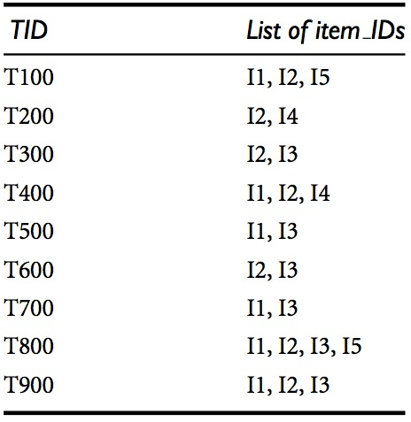

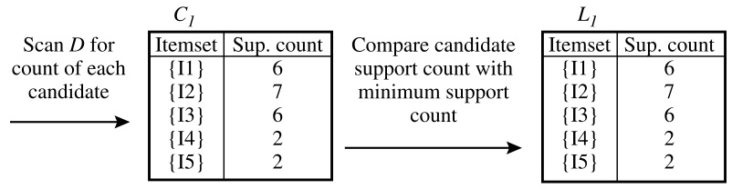
The Apriori Algorithm: Example
Find frequent itemsets with minimum support count equals 2!
minSupCount = 2
Notes:
Min sup = 2 = 2/9 = 0.22…
In the first iteration of the algorithm, each item is a member of the set of candidate 1-itemsets, C1. The algorithm simply scans all of the transactions in order to count the number of occurrences of each item.
Suppose that the minimum support count required is 2, that is, min sup = 2. (Here, we are referring to absolute support because we are using a support count. The corresponding relative support is 2/9 = 22%). The set of frequent 1-itemsets, L1, can then be determined. It consists of the candidate 1-itemsets satisfying minimum support. In our example, all of the candidates in C1 satisfy minimum support.
C2, C3: generated using combination
L1: 1-itemset
L2: 2-itemset
L3: 3-itemset

Slide 20
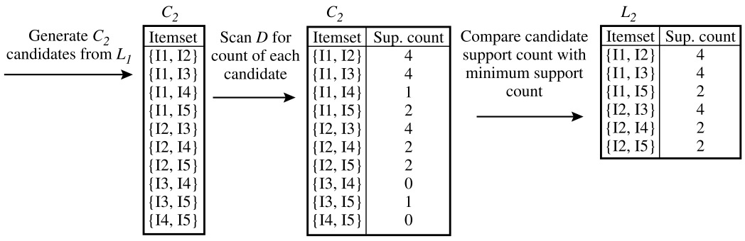
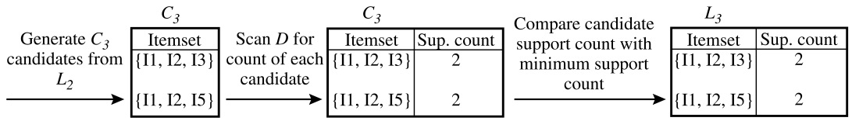
The Apriori Algorithm: Example (cont.)
{I1, I2, I4}
{I1, I2, I4} 1
Notes:
To discover the set of frequent 2-itemsets, L2, the algorithm uses the join L1 on L1 to generate a candidate set of 2-itemsets, C2.8 C2 consists of |L1| 2-itemsets. Note that no candidates are removed from C2 during the prune step because each subset of the candidates is also frequent.
Next, the transactions in D are scanned and the support count of each candidate item-set in C2 is accumulated, as shown in the middle table of the first row in Figure
The set of frequent 2-itemsets, L2, is then determined, consisting of those candidate 2-itemsets in C2 having minimum support.
First get C3 = L2 on L2 = {{I1, I2, I3}, {I1, I2, I5}, {I1, I3, I5}, {I2, I3, I4}, {I2, I3, I5}, {I2, I4, I5}}. Based on the Apriori property that all subsets of a frequent itemset must also be frequent, we can determine that the four latter candidates cannot possibly be frequent. We therefore remove them from C3, thereby saving the effort of unnecessarily obtaining their counts during the subsequent scan of D to determine L3. Note that when given a candidate k-itemset, we only need to check if its (k 1)-subsets are frequent since the Apriori algorithm uses a level-wise search strategy. The resulting pruned version of C3 is shown in the first table of the bottom row of Figure
The transactions in D are scanned in order to determine L3, consisting of those candidate 3-itemsets in C3 having minimum support
The algorithm uses L3 on L3 to generate a candidate set of 4-itemsets, C4. Although the join results in {{I1, I2, I3, I5}}, this itemset is pruned because its subset {{I2, I3, I5}} is not frequent. Thus, C4 = f, and the algorithm terminates, having found all of the frequent itemsets.

Slide 21
The Apriori Algorithm: Example (cont.)
L₄
Generate C4
candidates from L3
Itemset | Sup. count
{I1, I2, I3, I5} | 1
Doesn’t pass the threshold
DONE
Output:
The frequent itemsets that meet the requirement:
{I1, I2, I3} {I1, I2, I5} {I1, I2} {I1, I3} {I1, I5} | {I2, I3} {I2, I4} {I2, I5} {I1} {I2} | {I3} {I4} {I5}

Slide 22
Generating Association Rules from Frequent Itemsets
Association rules can be generated as follows:
  For each frequent itemset l, generate all nonempty subsets of l
  For every nonempty subset s of l, output the rule “s => (l – s)” if support_count(l)/support_count(s) ≥ min_conf
Example:
  Suppose the data contain the frequent itemset l = {I1, I2, I5}
  The nonempty subsets of l are :
  {I1, I2}, {I1, I5}, {I2, I5}, {I1}, {I2}, and {I5}
  The resulting association rules:
Rule | Confidence
I1^I2 → I5 I1^I5 → I2 I2^I5 → I1 I1 → I2^I5 I2 → I1^I5 I5 → I1^I2 | 2/4 = 50% 2/2 = 100% 2/2 = 100% 2/6 = 33% 2/7 = 29% 2/2 = 100%
Suppose min_conf = 70%

Slide 23
FP-Growth Algorithm
Use a compressed representation of the database using an FP-tree.
Once an FP-tree has been constructed, it uses a recursive divide-and-conquer approach to mine the frequent itemsets.

Slide 24
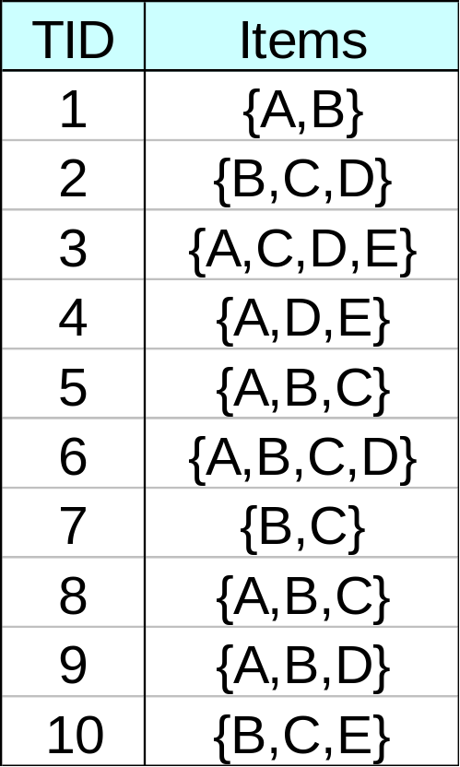
FP-Tree Construction
null
After reading TID=1:
A:1
B:1
After reading TID=2:
null
A:1
B:1
B:1
C:1
D:1

Slide 25
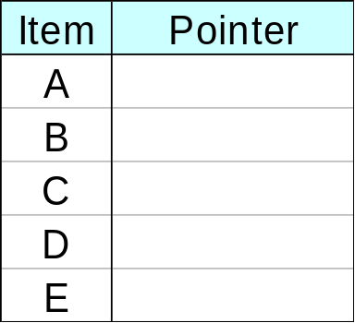
FP-Tree Construction (cont.)
Transaction Database
null
A:7
B:3
B:5
C:3
C:1
D:1
Header table
D:1
C:3
E:1
D:1
E:1
D:1
E:1
D:1
Pointers are used to assist frequent itemset generation

Slide 26
FP-Growth
null
Conditional Pattern base for D:
P = {(A:1,B:1,C:1),
(A:1,B:1),
(A:1,C:1),
(A:1),
(B:1,C:1)}
Recursively apply FP-growth on P
Frequent Itemsets found (with sup > 1):
AD, BD, CD, ACD, BCD
A:7
B:1
B:5
C:1
C:1
D:1
C:3
D:1
D:1
D:1
D:1

Slide 27
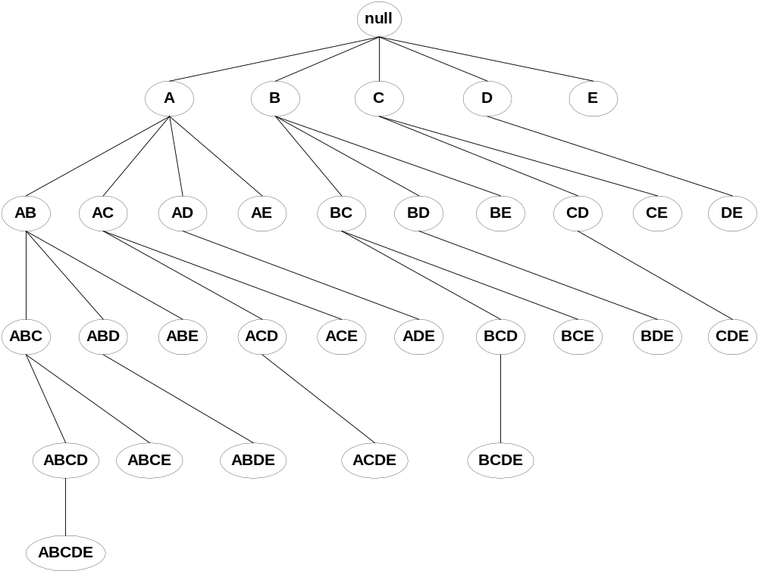
Tree Projection
Set enumeration tree:
Possible Extension: E(A) = {B,C,D,E}
Possible Extension: E(ABC) = {D,E}

Slide 28
Why is FP-Growth the Winner?
Divide-and-conquer:
  decompose both the mining task and DB according to the frequent patterns obtained so far
  leads to focused search of smaller databases
Other factors
  no candidate generation, no candidate test
  compressed database: FP-tree structure
  no repeated scan of entire database
  basic ops—counting local freq items and building sub FP-tree, no pattern search and matching

Slide 29
Evaluation of Association Rules
Association rule algorithms tend to produce too many rules.
  Many of them are uninteresting or redundant.
  Redundant if {A,B,C} → {D} and {A,B} → {D}
  have same support & confidence.
Interestingness measures can be used to prune/rank the derived patterns.
In the original formulation of association rules, support & confidence are the only measures used.

Slide 30
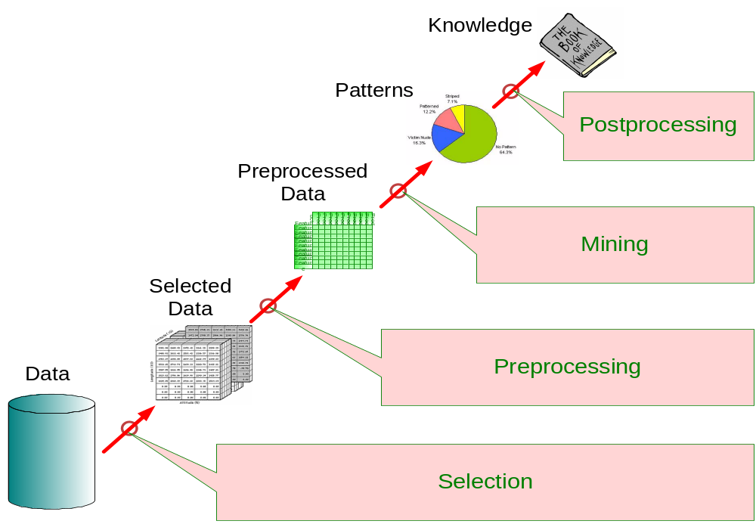
Application of Interestingness Measure
Interestingness Measures

Slide 31
Computing Interestingness Measure
Given a rule X → Y, information needed to compute rule interestingness can be obtained from a contingency table.
Contingency table for X → Y
 | Y | Y
X | f₁₁ | f₁₀ | f₁₊
X | f₀₁ | f₀₀ | f_{o+}
 | f₊₁ | f₊₀ | |T|
f₁₁: support of X and Y
f₁₀: support of X and Y
f₀₁: support of X and Y
f₀₀: support of X and Y
Used to define various measures
support, confidence, lift, Gini,
J-measure, etc.

Slide 32
Drawback of Confidence
 | Coffee | Coffee
Tea | 15 | 5 | 20
Tea | 75 | 5 | 80
 | 90 | 10 | 100
Association Rule: Tea → Coffee
Confidence= P(Coffee|Tea) = 0.75
but P(Coffee) = 0.9
Although confidence is high, rule is misleading
P(Coffee|Tea) = 0.9375

Slide 33
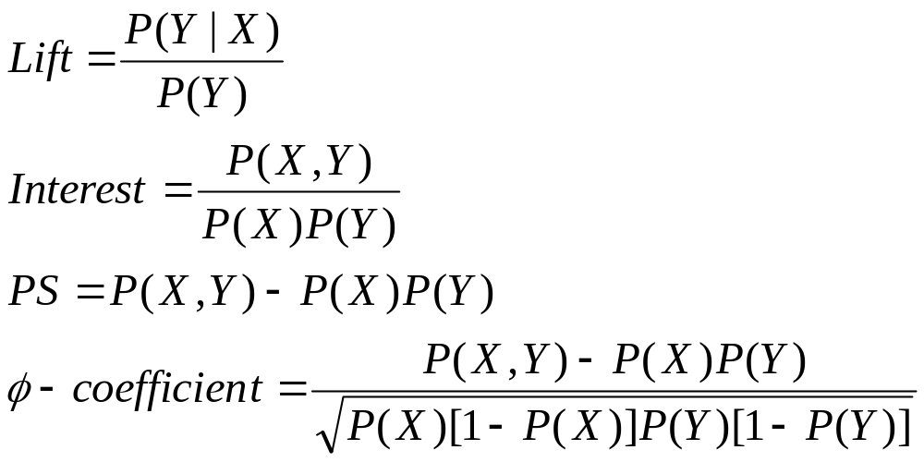
Statistical-Based Measures
Measures that consider statistical dependence:

Slide 34
Subjective Interestingness Measure
Objective measure:
  Rank patterns based on statistics computed from data.
  e.g., 21 measures of association (support, confidence, Laplace, Gini, mutual information, Jaccard, etc).
Subjective measure:
  Rank patterns according to user’s interpretation
    A pattern is subjectively interesting if it contradicts the expectation of a user (Silberschatz & Tuzhilin).
    A pattern is subjectively interesting if it is actionable (Silberschatz & Tuzhilin).

Slide 35
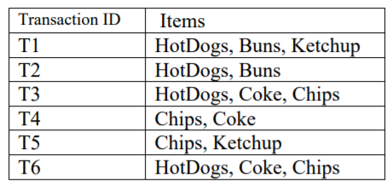
Exercise
Trace the results of using the Apriori algorithm on the grocery store transactions above with support threshold s=33.34% and confidence threshold c=60%. Show the candidate and frequent itemsets for each database scan. Enumerate all the final frequent itemsets. Also indicate the association rules that are generated and highlight the strong ones, sort them by confidence.

Slide 36
References
Bishop, C. M. (2006). Pattern recognition and machine learning. springer.
Harrington, P. (2012). Machine learning in action. Manning Publications Co..

Slide 37
Q&A

Slide 38


